Slide 1
HNDIT1212 System Analysis and Design
Feasibility Study

Slide 2
Feasibility study
The measure of how beneficial an information system will be to an organization.
Categories of feasibility tests,
Operational Feasibility
Cultural / Political Feasibility
Technical Feasibility
Schedule Feasibility
Economic Feasibility
Legal Feasibility

Slide 3
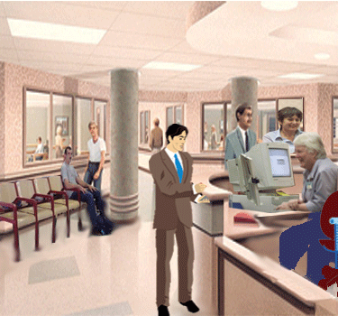
Operational Feasibility
It is a measure of how well a solution meets the identified system requirements to solve the problem.

Slide 4

Cultural (or Political) Feasibility
Cultural feasibility deals with how the end users feel about the proposed system.
Cultural feasibility also asks,
Will the solution fulfill the users’ requirements?
How will the solution change the users’ work environment?
How do users feel about such a solution?

Slide 5
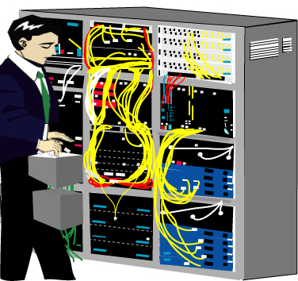
Technical Feasibility
It is a measure of the practicality of a technical solution
availability of technical recourses and expertise
Notes:
ýÔæßõÚ ÑúÀÚù<$

Slide 6
Technical Feasibility……..
Technical feasibility addresses three major issues:
Is the proposed technology or solution practical?
Do we currently possess the necessary technology (Hardware/Personnel) ?
Do we possess the necessary technical expertise?

Slide 7
Schedule Feasibility
A measure of how reasonable a project time table is.
Schedule feasibility also asks,
can the solution be designed and implemented within an acceptable time period?
how much time is available to build the new system?
when can it be built ?

Slide 8

Legal Feasibility
It is a measure of how well a solution can be implemented within existing legal and contractual obligations.
copyright law (licensed agreements should not be violated)
non-disclosure clauses
code ownership (if developed with outside assistance)
labour laws
foreign trade, and labour regulations
Financial & Accounting standards

Slide 9

Economic Feasibility
It is a measure of the cost-effectiveness of a project.
Is the solution cost-effective?
How profitable the solution is?

Slide 10
Cost-benefit analysis
Cost-benefit analysis is always included both tangible and intangible items.
Tangible items are those to which direct values can be attached
Equipment costs for the new system
Personnel cost
Material costs
Conversion cost
Other costs(consultant’s cost)

Slide 11
Cost-benefit analysis cont..
Intangible items, are those whose values cannot be exactly determined
How much is saved by completing a project earlier or providing new information to decision makers?

Slide 12
Determining whether a project is worthwhile
There are two ways to do this:
Payback method
Payback method defines the time required to recover the money spent on a project.
Present value method
That method is determine how much money it is worthwhile investing now in order to receive a given return in some year’s time.

Slide 13
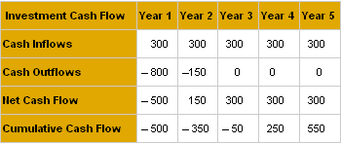
Payback method
Q1:Payback Period Example
The investment
The initial cost of
the investment
The net of cash
inflows and outflows
for each year
The sum of all cash
inflows and outflows

Slide 14
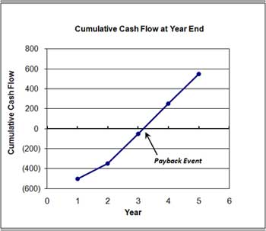
Payback Period = Y + ( A / B ) where
Y = The number of years before final payback year.
In the example, Y = 3.0 years.
A = Total remaining to be paid back at the start of the payback year, to bring cumulative cash flow to 0.
In the example, A = $50.
B = Total (net) paid back in the entire payback year.
In the example, B = 300.
For the example,
Payback Period = 3+ (50) / (300)
Payback Period = 3 + 1/6 = 3.17 Years
payback may occur any time in year 4

Slide 15
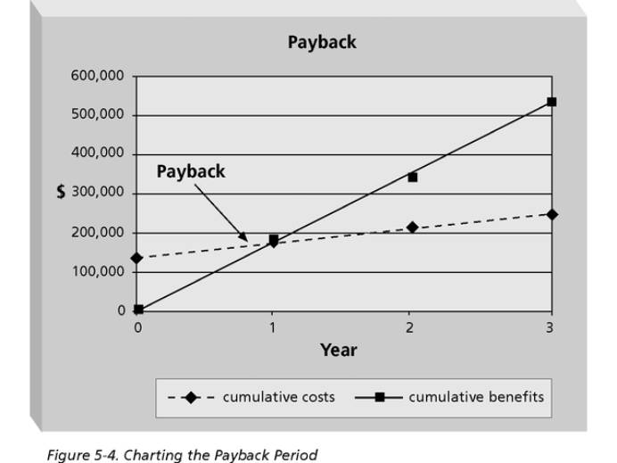
Charting the Payback Period

Slide 16
Payback method
Q2:
The initial investment in a pollution prevention project is $10,000. The projected savings is $4,000 for the first year, $4,000 for the second year, $2,500 for the third year, $2,000 in the fourth year, and $2,000 for the fifth year. The payback would be at 2.8 years

Slide 17
year | cash inflow | cash outflows | net of cash | cumulative cash
0 |  | -10000 | -10000 | -10000
1 | 4000 | 0 | 4000 | -6000
2 | 4000 | 0 | 4000 | -2000
3 | 2500 | 0 | 2500 | 500
4 | 2000 | 0 | 2000 | 2500
5 | 2000 | 0 | 2000 | 4500
=The number of years before final payback year.+(Total remaining to be paid back at
the start of the payback year, to bring cumulative cash flow to 0)/(B = Total (net) paid
back in the entire payback year)
=2+(0-(-2000))/(500-(-2000))
=2+2000/2500=2.8

Slide 18
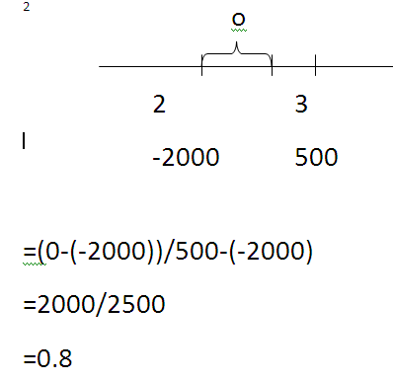

Slide 19
Q3 :
The following company invests $10,000 initially into a corner store investment. The cash flows from Years 1-6 are provided in the table. What is the Payback Period?
 | Cash Flows
Year 1 | 1500
Year 2 | 2500
Year 3 | 4000
Year 4 | 3000
Year 5 | 3000
Year 6 | 3000

Slide 20
 | Cash Flows | Cumulative Cash Flows
Initial Investment | -$10,000 | $-10,000
Year 1 | 1500 | -8500
Year 2 | 2500 | -6000
Year 3 | 4000 | -2000
Year 4 | 3000 | +1000
Year 5 | 3000 | +4000
Year 6 | 3000 | +7000
Payback Period = 3 years + $2000 / $3000 = 3.67 Years

Slide 21
Limitations & Disadvantages of using the Payback Period Rule
The Payback Period does not take into account time value of money.
Since we are just adding up the future cash flows e.g $2500 in Year 2, $3000 in Year 3, etc, we are not discounting these payments and adjusting them for time value of money.

Slide 22
company wants to invest in a project costing Rs.10,000 and expects to generate cash flows of Rs.5,000 in year 1, Rs.4,000 in year 2, and Rs.3,000 in year 3. The weighted average cost of capital is 10%.

Slide 23
First, discount the cash flows back to the present or to their present value. Here are the calculations:
Year 0: -Rs.10,000/(1+.10)^0 = Rs.10,000
Year 1: Rs.5000/(1+.10)^1= Rs.4,545.45
Year 2: Rs.4000/(1+.10)^2= Rs.3,305.79
Year 3: Rs.3000/(1+.10)^3= Rs.2,253.94

Slide 24
Step 2 is to calculate the cumulative discounted cash flows:
Year 0: -Rs.10,000
Year 1: -Rs. 5,454.55
Year 2: -Rs. 2,148.76
Year 3: Rs. 105.18
DPP = 2 + Rs.2,148.76/Rs.2,253.94 = 2.95 years

Slide 25
Discounted Pay-back period method:
Example: A project with initial investment of $20,000 and cash inflows of $5,000 for 10 years, if discounted at 15%, the discounted pay-back period would be?

Slide 26
Using Q3
Year | Cash Flows | PV of Cash Flows | Cumulative Cash Flows
0 | -$10,000 | -$10,000 | $-10,000
1 | 1500 | 1389 | -8611
2 | 2500 | 2143 | -6468
3 | 4000 | 3175 | -3293
4 | 3000 | 2205 | -1088
5 | 3000 | 2042 | +954
6 | 3000 | 1891 | +2845
Discounted Payback Period = 4 Years + (1088 / 2042) = 4.53 Years

Slide 27
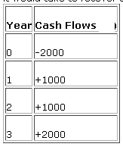

Slide 28
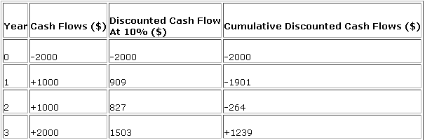

Slide 29
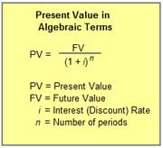
Present value method
What is the Present Value of $100 we will receive in 5 Years, using a 5% discount rate?
PV₅ = $100 / (1.0 +0.05)⁵
= $100 / (1.276)
= $75.13

Slide 30
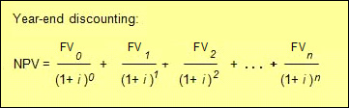
Net Present Value for the stream is the sum of PVs for each FV:

Slide 31
Consider two competing investments in computer equipment.
Each calls for an initial cash outlay of $100, and each returns a total a $200 over the next 5 years making net gain of $100. But the timing of the returns is different, as shown in the table.
Using a 10% discount rate again

Slide 32
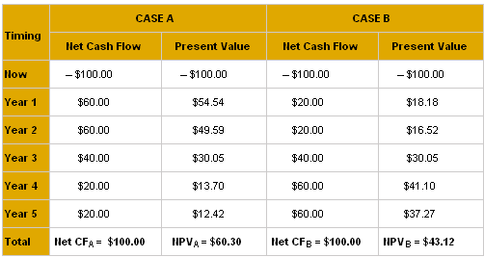
the higher NPV is the better investment.

Slide 34
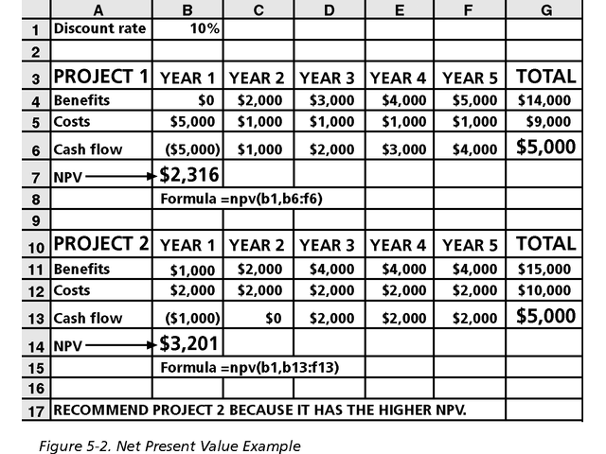
Net Present Value Example
Note
that
totals
are
equal,
but
NPVs
are
not.
Uses
Excel’s
npv
function

Slide 35
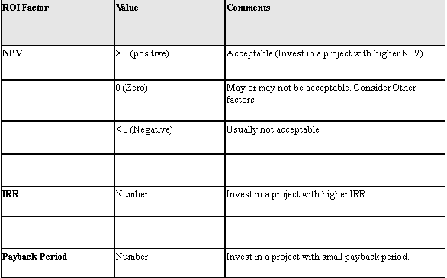

Slide 36
Example: Project to create ecommerce website to sell your products online may provide the following cash flow
Current Year: Expected to spend $10,000 to develop the website.(One year time-frame – not a capital project)
Year-1: After website is deployed, it is expected to generate $4,000 in the first year.
Year-2: Expected to generate $5,000 in the second year.
Year-3: Expected to generate $5,000 in the third year
Year-4: Expected to generate $2,000 in the fourth year.
Year-5: Expected to generate $2,000 in the fifth year.
If a bank would give you a 10% interest on the investment. Find the net present value for this investment

Slide 37
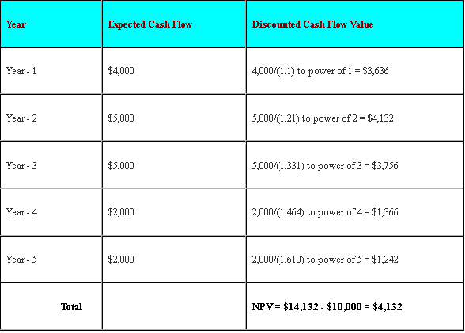

Slide 38
Activities in problem definition and feasibility analysis
Problems
and ideas
Problem definition
System
deficiencies
Identify system deficiencies
Mission
Develop project goals
User needs
Selected
alternative
Possible
revision
Feasibility study
System
deficiencies
goals
Generate broad alternative solutions
Problems
boundaries
Evaluate feasibility
Alternatives
Constraints

Slide 39
Feasibility Analysis of candidate systems
Use two alternatives to compare and contrast candidate system solutions
Candidate System Matrix
Feasibility Analysis Matrix

Slide 40
Candidate System Matrix
Identify how the system will interact with people, and other systems
How data stores be implemented, inputs will be captured, outputs will be generate
How computer processes will be implemented
Identify how processed and data will be distributed
 | Canditate1 | Canditate1 | Canditate1
Stakeholders
Knowledge
Processes
Communication

Slide 41
Feasibility Analysis Matrix
 | Weighting | Candidate 1 | Candidate 2 | Candidate 3
Description
Operational Feasibility
Cultural Feasibility
Technical Feasibility
Economic Feasibility
Legal Feasibility
Weighted Score

